Slide 1


Unveiling Misalignment Fault Severities: A Novel SCD-CNN Framework for Rotating Machinery
Dilshara Herath*, Chinthaka Abeyrathne*, Chamindu Adithya†, Chathura Seneviratne*
*Department of Electrical and Information Engineering, †Department of Mechanical and Manufacturing Engineering
*†Faculty of Engineering, University of Ruhuna
Galle, Sri Lanka
T9 : Image Processing and Computer Vision
Presentation Date: 08/14/2025

Slide 2




Team & Collaborators
Dilshara Herath
Electrical and information Engineering
University of Ruhuna.
Chinthaka Abeyrathne
Electrical and Information Engineering
University of Ruhuna
Supervisor
Chamindu Adithya
Mechanical and Manufacturing Engineering
University of Ruhuna
Dr. Chatura Senevirathne
Senior Lecturer
Department of Electrical and Information Engineering
University Ruhuna
1

Slide 3

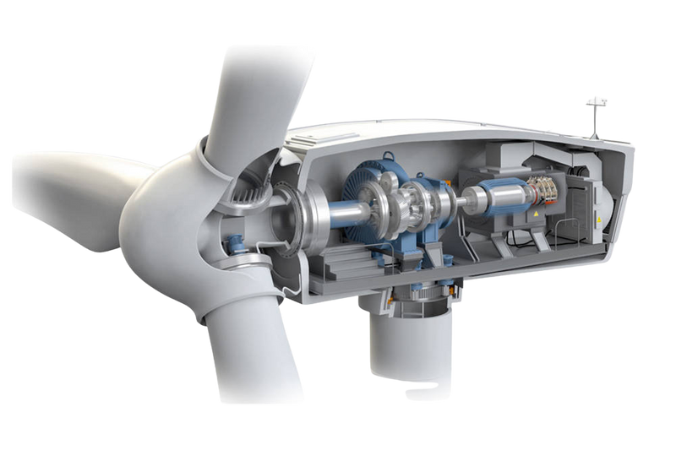
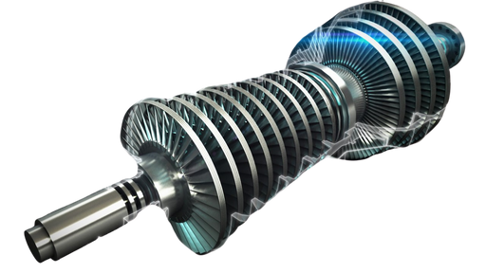
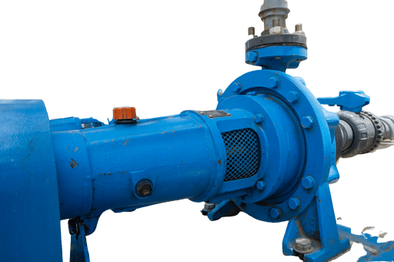
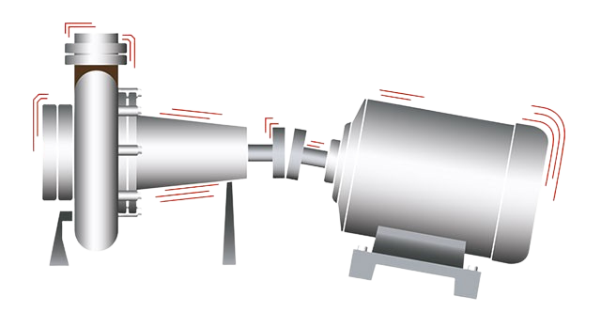
Introduction
Misalignment in rotating machinery occurs when coupled components are not co-linear.
Misalignment silently kills assets,
Vibrations
Wear
Premature failures
Early detection is critical for
Reducing downtime
Reducing maintenance costs.
Figure 1: Misalignment in Shaft
Unveiling Misalignment Fault Severities: a Novel SCD-CNN Framework for Rotating Machinery
2

Slide 4
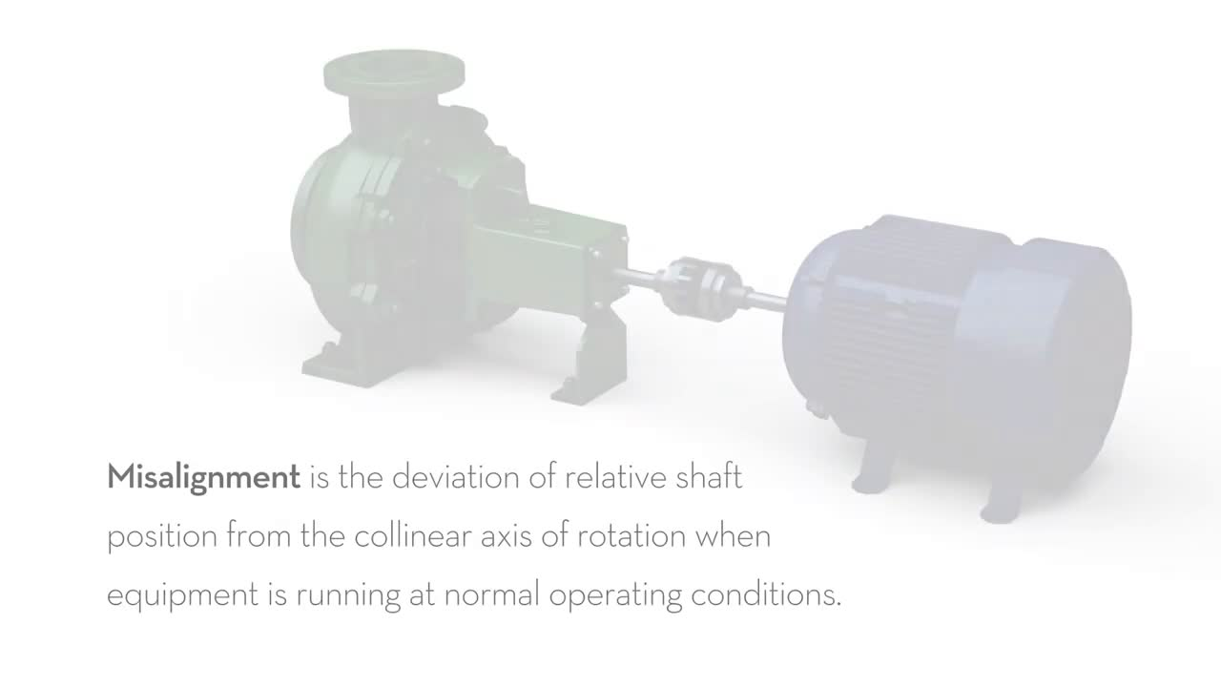
Shaft Misalignment?

Slide 5

Related Work
Method | Limitation
Time-domain & wavelet analysis | Limited Robustness
Frequency-domain analysis | Loses time-localization, Manual Inspection
Multi-sensor fusion | High Cost, Complex
Domain adaptation & decomposition | Computationally Heavy
Gaps: Poor noise handling, high cost, limited generalization.
Unveiling Misalignment Fault Severities: a Novel SCD-CNN Framework for Rotating Machinery
4

Slide 6


Objectives & Contributions
Develop a noise-robust, scalable, deep-learning-based framework for detecting shaft misalignment using vibration data.
Innovative integrated Framework: cyclostationary Signal Processing + Deep Learning
Noise-Robust Design: Improved generalization, diverse noise suppression capabilities
Benchmark Dataset Evaluation: A publicly accessible Rotating Machinery Vibration dataset, both normal and defective misalignment states, diverse loads
Unveiling Misalignment Fault Severities: a Novel SCD-CNN Framework for Rotating Machinery
5

Slide 7
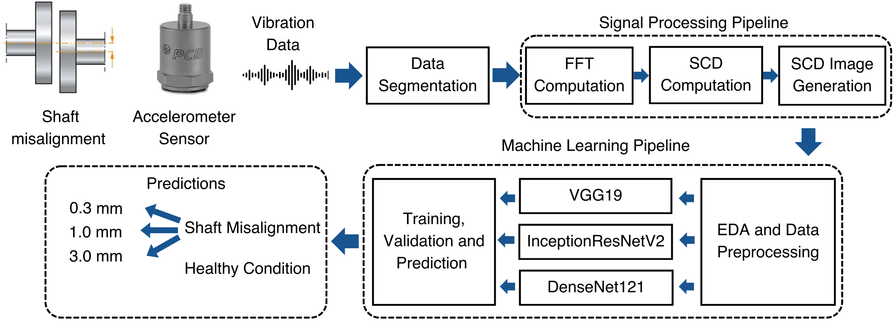
System Architecture
Figure 2: Complete System Architecture of the Rotating Machinery Fault Monitoring System
Unveiling Misalignment Fault Severities: a Novel SCD-CNN Framework for Rotating Machinery
6

Slide 8
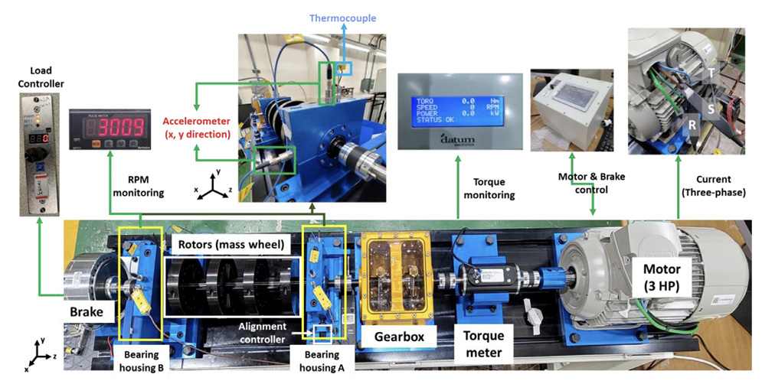

Dataset
load conditions:
0Nm
2Nm
4Nm
Vibration Data: Two accelerometers mounted on the housings of bearings A and B.
Housing A
Housing B
Figure 3: Layout of the rotating machine testbed and its components
Unveiling Misalignment Fault Severities: a Novel SCD-CNN Framework for Rotating Machinery
7

Slide 9
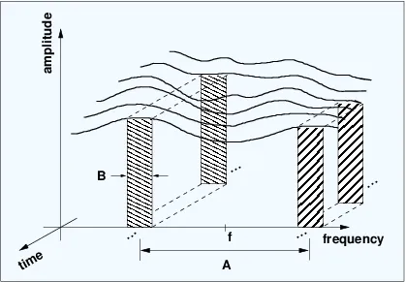
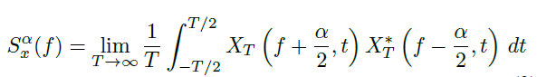
Signal Processing
Why Cyclostationary Property Analysis?
A cyclostationary process is a signal having statistical properties that vary cyclically with time.
Spectral correlation analysis, a key tool for cyclostationary signals, in identifying the periodicities in the frequency domain.
Suitable for complex environments with multiple noise.
Figure 4 : Concept of Spectral Correlation.
Unveiling Misalignment Fault Severities: a Novel SCD-CNN Framework for Rotating Machinery
8

Slide 10
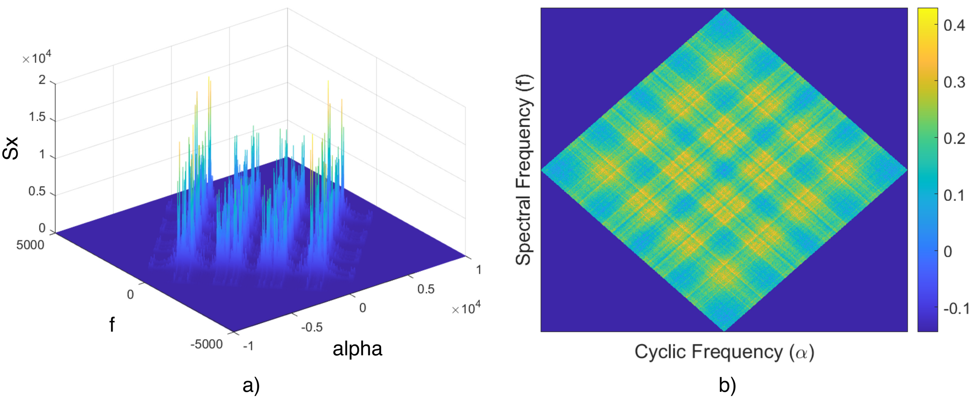
Cyclostationary Property Analysis
a) 3D Representation
a) 2D Representation
Figure 5: Spectral Correlation Density plots for 0.1mm Misalignment
f - Spectral frequency
α - cyclic frequency
Sx(f, α) - Spectral correlation density magntiude
Unveiling Misalignment Fault Severities: a Novel SCD-CNN Framework for Rotating Machinery
9

Slide 11
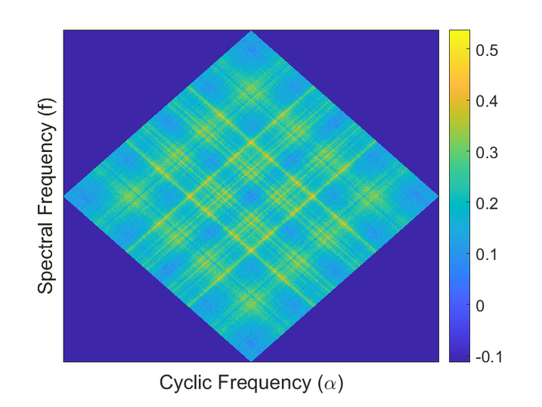
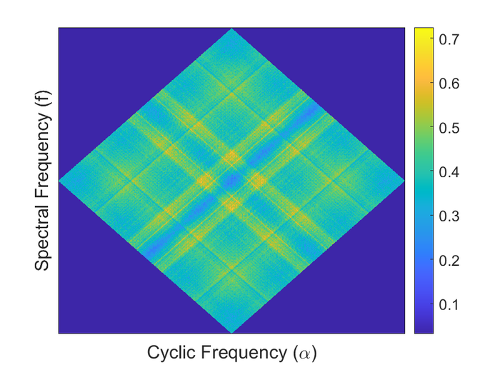
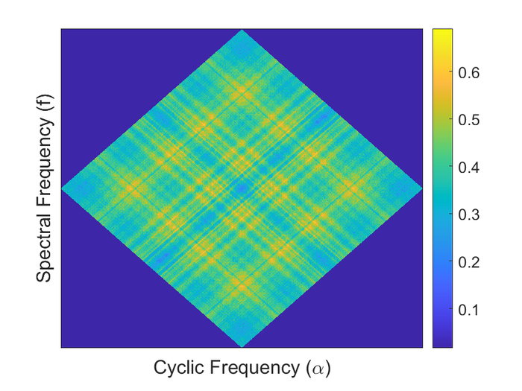
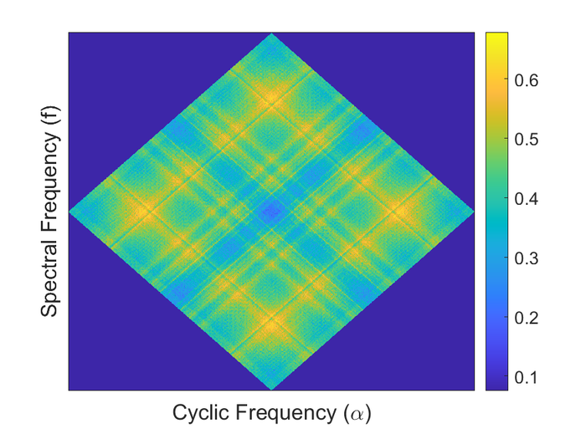
Spectral Correlation Density
SCD Patterns for different conditions
a) Healthy Bearing
b) Misalign: 0.1mm
c) Misalign: 0.3mm
d) Misalign: 0.5mm
a)
b)
c)
d)
Unveiling Misalignment Fault Severities: a Novel SCD-CNN Framework for Rotating Machinery
10

Slide 12
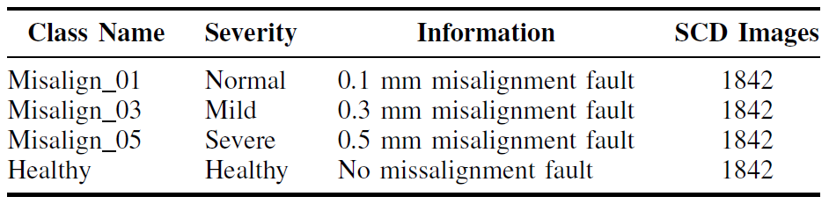
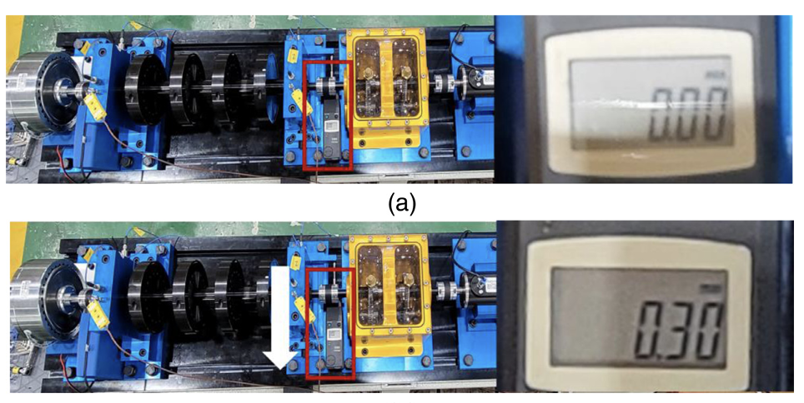
Dataset Description
7368
Total of 14,736 SCD images to train the CNN models
Figure 5: Description of shaft misalignment
Unveiling Misalignment Fault Severities: a Novel SCD-CNN Framework for Rotating Machinery
11

Slide 13
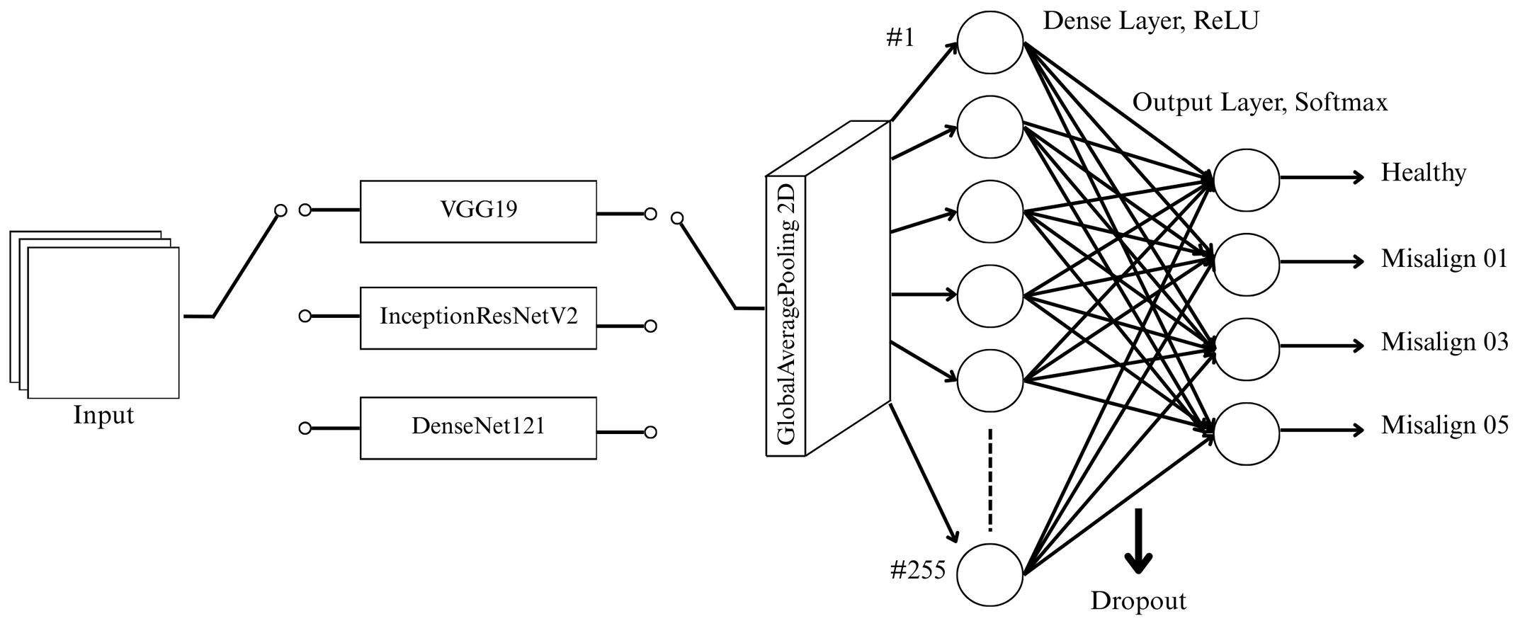
DL Model Pipeline
Batch Size=32, shuffle, prefetch
Training : 70%
Testing : 20%
Validation: 10%
Unveiling Misalignment Fault Severities: a Novel SCD-CNN Framework for Rotating Machinery
12

Slide 14
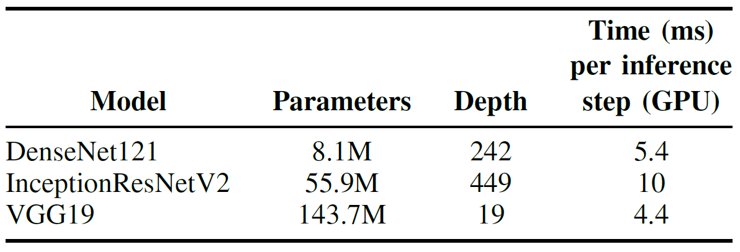
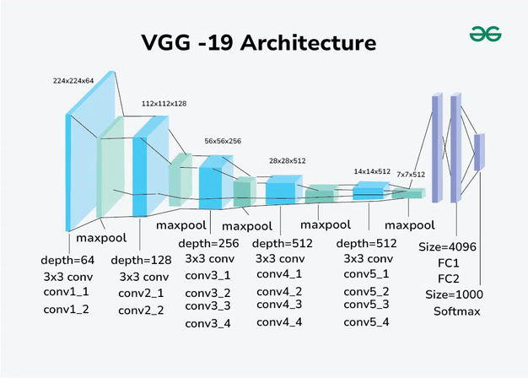


Deep Learning Models
Unveiling Misalignment Fault Severities: a Novel SCD-CNN Framework for Rotating Machinery
13

Slide 15
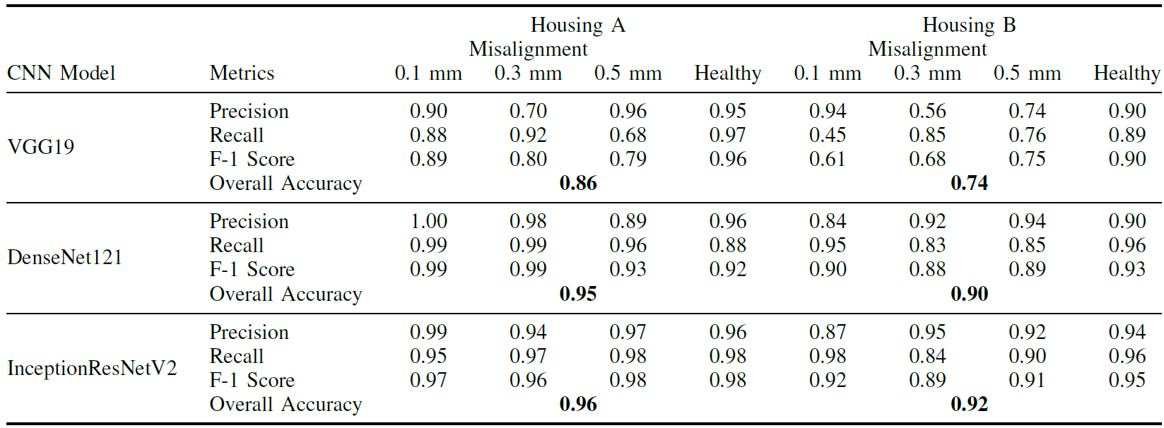

Performane of DL Models
TABLE 1: PERFORMANCE COMPARISON OF VGG19, DENSENET121, AND INCEPTIONRESNETV2
Unveiling Misalignment Fault Severities: a Novel SCD-CNN Framework for Rotating Machinery
14

Slide 16


Results & Discussion
As missed alarms are cost-critical in condition monitoring, recall is treated as a primary metric.
VGG19, with its deep stack of 3x3 convolutional layers,
computationally intensive
susceptible to overfitting
Recall drops to 0.45
DenseNet121,
high overall accuracies (95%for Housing A, 90% for Housing B)
strong recall 0.99
InceptionResNetV2, leveraging multi-scale feature extraction and residual connections,
highest accuracies (96%for Housing A, 92% for Housing B)
robust recall
Unveiling Misalignment Fault Severities: a Novel SCD-CNN Framework for Rotating Machinery
15

Slide 17
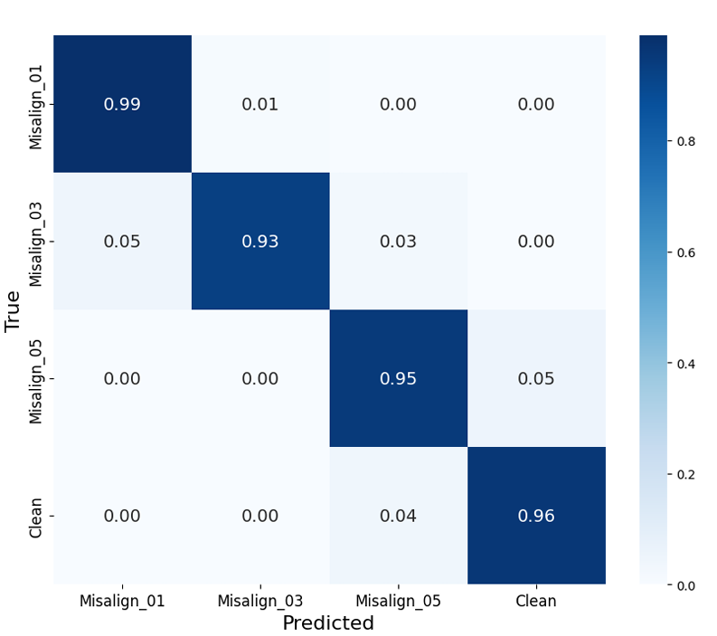
Results
Housing A is directly impacted by the fault,
Although, both housings provide superior performance with little variance in accuracy and recall.
Minimal false positives and negatives,
Excellent precision
Reliable for distinguishing alignment conditions
Unveiling Misalignment Fault Severities: a Novel SCD-CNN Framework for Rotating Machinery
16

Slide 18

Conclusion
InceptionResNetV2 achieved the best performance
Housing A: 96% accuracy and 0.98 recall
Housing B: 92% accuracy and 0.96 recall
Consistent performance across varying load conditions (0 Nm, 2 Nm, 4 Nm)
Cyclostationary SCD → CNN surfaces fault modulations and learns severity from vibration.
Accurate with either housing → easier installs, earlier interventions, fewer surprises
Limitations: Evaluated on parallel misalignment and one testbed; mild overfitting signs.
Small offsets, big signals: SCD makes them visible; CNN makes them actionable!
Unveiling Misalignment Fault Severities: a Novel SCD-CNN Framework for Rotating Machinery
17
9

Slide 19

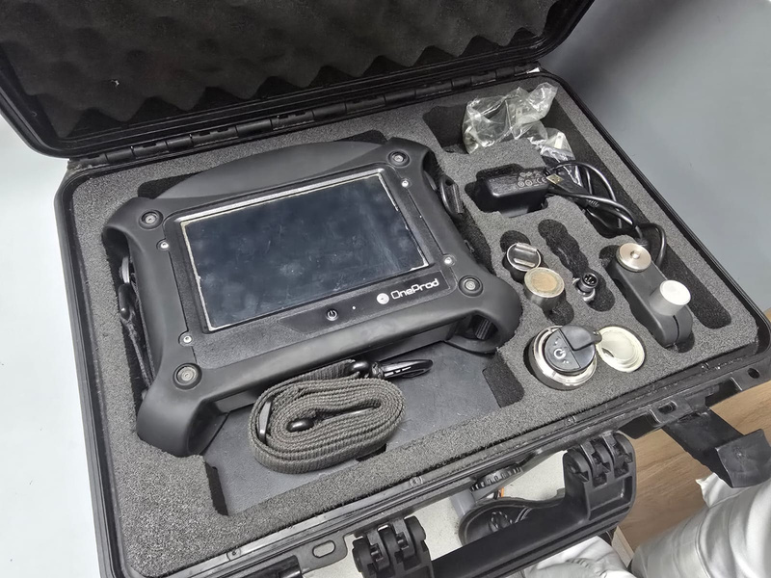
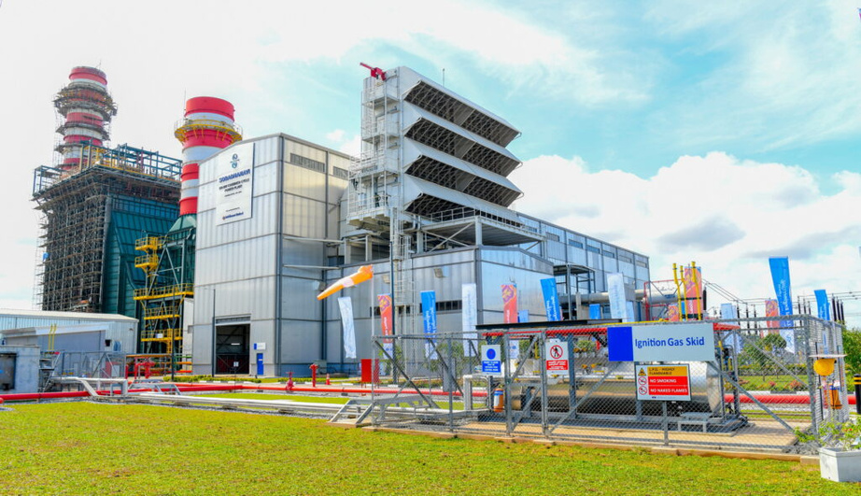
Future Work
Extend model to detect rotor unbalance and various bearing faults.
Real world vibration data from Yugadhanavi and Sobadhanavi plants.
Validate performance under real operating conditions at aforementioned plants.
Develop an interface usable by non-technical personnel.
Unveiling Misalignment Fault Severities: a Novel SCD-CNN Framework for Rotating Machinery
18

Slide 20
THANK YOU!

Slide 21
Q/A

